Slide 1

The Holy Spirit

Slide 2
OBJECTIVE
Participants will be able to gain an appreciation and understanding of the Holy Spirit and the Trinity (God the Father, the Son and the Holy Spirit).

Slide 3
Preview the Holy Spirit guides us!
For this unit on the Holy Spirit, read and discuss slide by slide. Let everyone participate in the reading of the given scriptures. Each section shows how the faith deepened and grew--and continues to deepen and grow. The words give us an outline of just what it is we do believe when we say the simple words, “I believe in the Holy Spirit.” Also, if students tend to not volunteer to answer questions, call on a random person. Participation makes people to understand better.

Slide 4
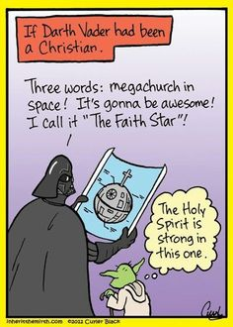
The Holy Spirit
We believe in the Holy Spirit, the giver of life, who proceeds from the Father and the Son. With the Father and the Son, He is worshipped and glorified. He has spoken through the prophets.
WE SAY THIS IN MASS EVERY TIME!!!

Slide 5
In the Holy Scriptures, the Holy Spirit is symbolized in several ways. Make a list of these symbols and discuss each of them with the group. (E.g - What is implied by the word hovering?).
To help develop your list, you may use the following passages:
Genesis 1:1-3 Exodus 12:21-22
Luke 9:34-35 Matthew 3:16
Acts 2:2-3

Slide 6
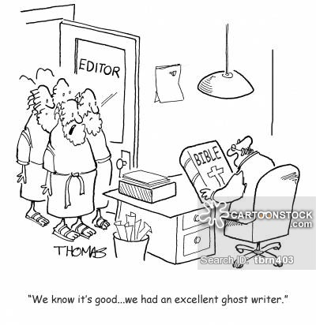
More than a figure of speech…
Unlike a lot of people of their time, the Hebrew people were monotheists, which means they believed there was only one almighty God, who created and controls the entire universe.

Slide 7
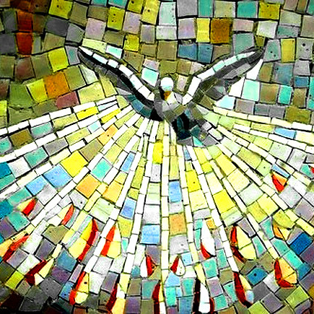
The Hebrews described their relationship with God in the scriptures over the centuries and often talked about the action of God’s word or God’s wisdom.

Slide 8
They often talked of the power and action of the spirit of god, sent upon some prophet or upon the people as a whole.

Slide 9
For example, God’s wisdom is described like this in Proverbs:
...then I (God’s wisdom) was beside Him (God), like a master worker; and I was daily His delight, rejoicing before him always, rejoicing in his inhabited world and delighting in the human race. Proverbs 8:30-31
These could seem to be figures of speech, like saying “The teacher’s word is law” or “When Mom arrived, her cheerful spirit filled the room.” but as you read the Old Testament, you will find many passages that give you the sense that God’s word and Spirit have a “personality” of their own.

Slide 10
In two or three columns
When the Apostles and the early Church pondered Jesus, all he said and did, and all the events surrounding his life, death, and resurrection, they came to realize this word (or wisdom) talked about in the Scriptures was none other than Jesus, the WORD made flesh! (John 1:1-3).

Slide 11
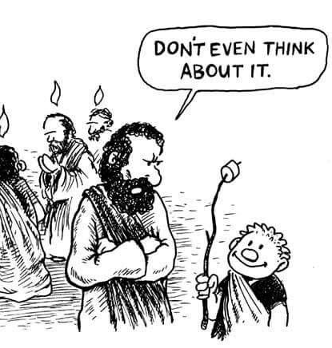
In the same way, they came to realized that the Advocate or Spirit whom Jesus promised to send upon them was more than a figure of speech. It was none other than God’s spirit spoken of so often in the Old Testament. God’s spirit was also a divine person, as are God the Father and Jesus, the Word. (John 14:26 & 15:26).

Slide 12
Scripture
Search
Read & discuss these passages to discover the various names for the Holy Spirit used by Paul.
Galatians 3:14 the _ _ _ _ _ _ _ of the Spirit
Romans 8:15 the Spirit of _ _ _ _ _ _ _ _
2 Corinthians 3:17 the Spirit of the _ _ _ _
Romans 8:9 the Spirit of _ _ _ _ _ _
Romans 8:14 The Spirit of _ _ _
What word did Jesus use for the Holy Spirit? _ _ _ _ _ _ _ _ _
1
6
2
5
3
4
7
1 2 3 2 4 5 6 7 6

Slide 13
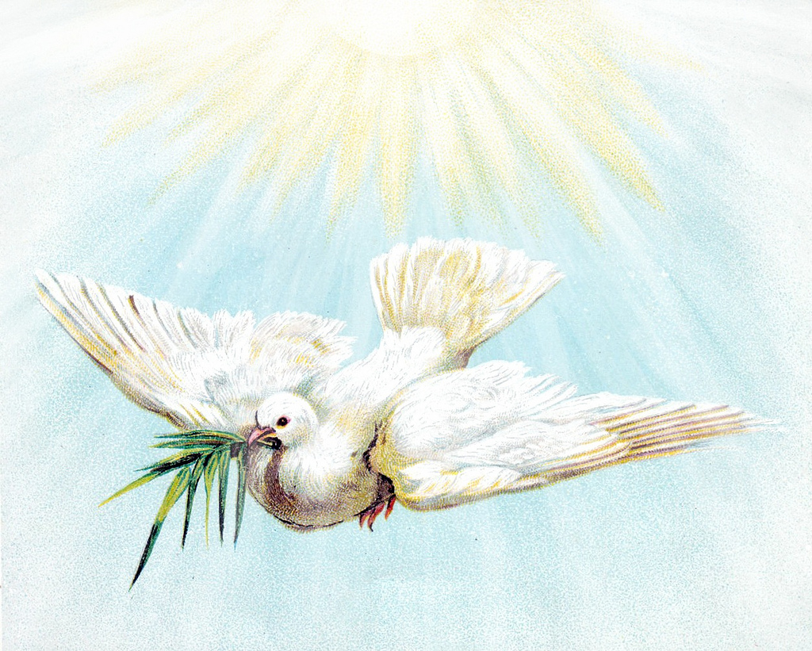
The words, “I believe in the Holy Spirit” express this unique Christian belief that the Holy Spirit is a divine person, equal to but distinct from the Father and the Son

Slide 14
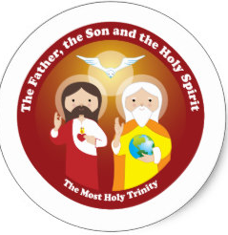
If the Holy Spirit is a Divine Person...
Father
Son
Holy Spirit
then our God is a Trinitarian God!

Slide 15
A basic belief of the Church is our belief in the Trinity.
Like the children of Abraham, we believe there is only one God, but unlike the Jews, we also believe that this one God is three divine persons!
The Father, Son, and Spirit are three distinct Persons, each sharing equally in all the qualities of one divine nature. (John 1:1-3).

Slide 16
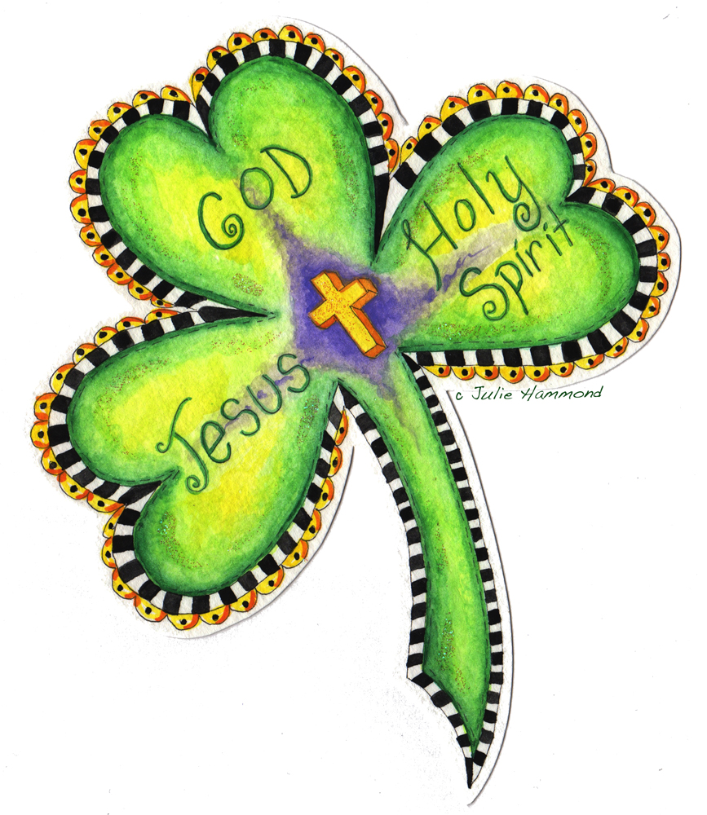
How did we learn of the Trinity?
It is through Jesus that we come to know about the Holy Trinity. There is no complete, logical explanation of the Father, Son, and Spirit stating that each can be God and yet there is only one God. We are at the heart of divine mystery- and faith- when we express our belief in the Trinity.
There are comparisons that help a little, the famous one by Saint Patrick, who taught his new converts that the Trinity is like a shamrock. Just as three shamrock petals share the common life of the stem, the three divine Persons share one divine nature.

Slide 17

Our God is a community of three divine Persons who share completely with each other all that they have and are. Jesus’ command that we love one another and share all that we have with each other is an invitation for us humans to imitate the very inner life of God. At the core of the life of our Trinitarian God is a life of total, mutual love, mutual sharing. God is LOVE!

Slide 18
What is said about this loving God and the Holy Spirit?
Look up
Romans 5:5
Draw an image of it
Decorate it and turn it in

Slide 19
Let’s review some concepts
At the core of all authentic human love, at the core of all true spiritual life is the power and action of the Holy Spirit, sent forth from the Father and the Son. In one of his letters, Paul describes what authentic love (and the action of the Holy Spirit) is like.
Paul writes:
Love is patient, love is kind. It does not envy, it does not boast, it is not proud. It does not dishonor others, it is not self-seeking, it is not easily angered, it keeps no record of wrongs. Love does not delight in evil but rejoices with the truth. It always protects, always trusts, always hopes, always perseveres. Love never fails. But where there are prophecies, they will cease; where there are tongues, they will be stilled; where there is knowledge, it will pass away.

Slide 20
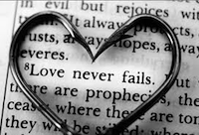
The Real Thing
Society’s ideas about love can differ greatly from what Paul says about authentic love. One big difference is that “false” love - the kind of misguided “love” that society seems to teach - is self-serving, while authentic love is other-serving. With a partner, discuss your ideas about false love and authentic love. As a class let us respond to the statement below.
False love says if you love me, you will…
Authentic love says because I love you, I will...

Slide 21

In another letter, Paul again describes the kind of life the Holy Spirit gives us. In this passage, he refers to the “fruit of the Holy Spirit”
...the fruit of the Spirit is love, joy, peace, patience, kindness, generosity, faithfulness, gentleness, and self-control...If we live by the Spirit, let us also be guided by the Spirit

Slide 22

Fruits of the Spirit, Continued...
On a piece of white paper, create a table that is 3 x 3. In each box (there should be 9) write the name of each fruit; Draw a symbol for each fruit of the Holy Spirit given below. On a piece of paper respond to the following two questions (1 paragraph, please), explain which fruit is most abundant in your life? In what ways can you see the fruits of the Spirit work in you?
Love Joy Peace
Patience Kindness Goodness
Faithfulness Gentleness Self-Control

Slide 23
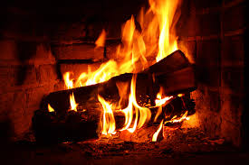
The Holy Spirit comes like a gentle dove.
Like a whisper of a summer breeze among the leaves.
The Spirit comes like a small flame that enlightens and warms.
The Holy Spirit heals, beautifies, and strengthens us.
Place your screenshot here

Slide 24
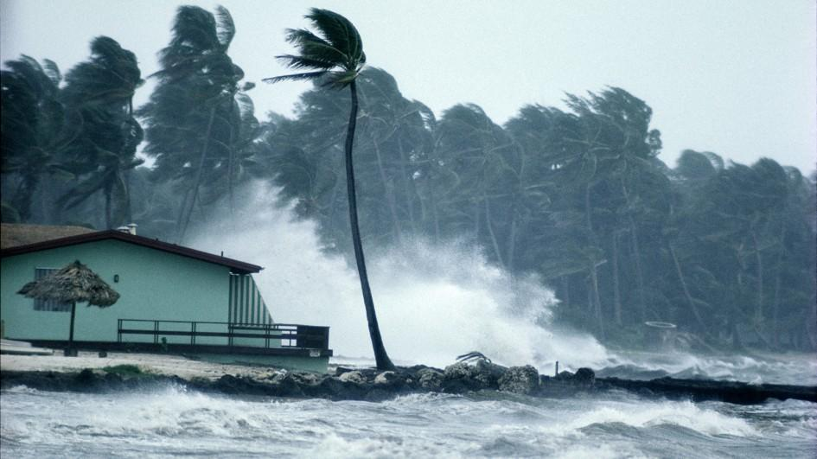
The Holy Spirit can also come like a raging hurricane that nothing can resist.
The Spirit can come like a roaring flame that sets everything on fire.
The Holy Spirit comes to comfort, heal, restore life, enlighten, strengthen, empower, and move people all in God’s name.
The Holy Spirit sets people on fire with love for God and the Holy Spirit speaks through the prophets.

Slide 25

In the time before Jesus, prophets were people who were inspired and spoke out in the name of God. Because they were filled with the Holy Spirit, prophets were gifted with a highly-developed spiritual sensitivity…a ”spiritual radar”

Slide 26
This sensitivity allowed the prophets to recognize even the slightest action or movement of God among the people.
It also enabled them to recognize the presence of evil forces of work, even when others didn’t.
They could see the long-range consequences if the people continued to cooperate with those evil forces.

Slide 27
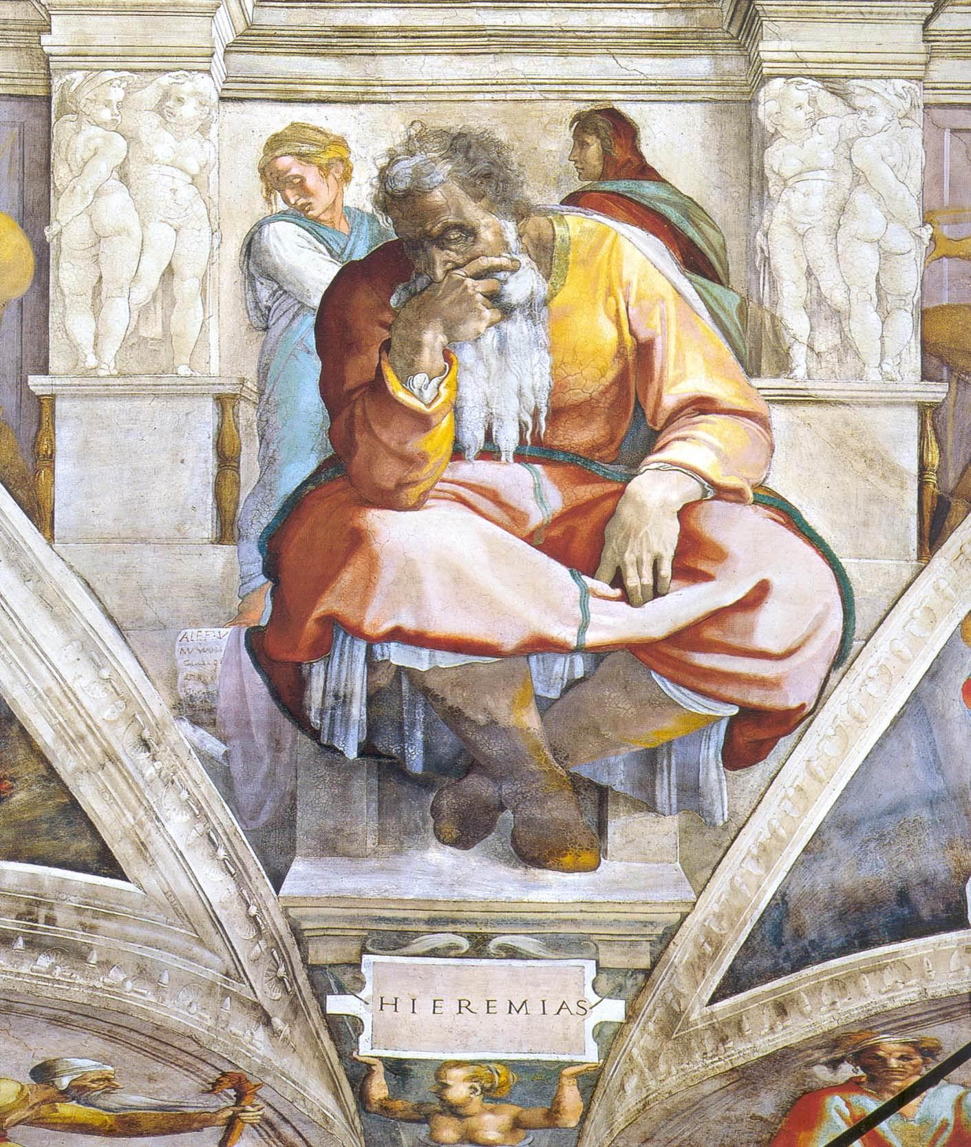
The prophet Jeremiah was a compelling man who was often rejected by his own people. He made pleas to the people to be faithful to their covenant with God. He predicted the fall of Jerusalem and the destruction of the Temple, which was the center of religious culture and worship among the Hebrews.

Slide 28
Read Jeremiah 1:4-10 to read about his call to prophecy.
Imagine Jeremiah was being interviewed on tv. Help answer the questions for him as he might if he were going to appear on TV.

Slide 29
Interview: The prophet Jeremiah
Q: When did you receive God’s “call” to be a prophet?
A:
Q: What was your first reaction to the “call”?
A:
Q: How do you know what to tell people?
A;
Q: What do you believe God wants you to do?
A:

Slide 30
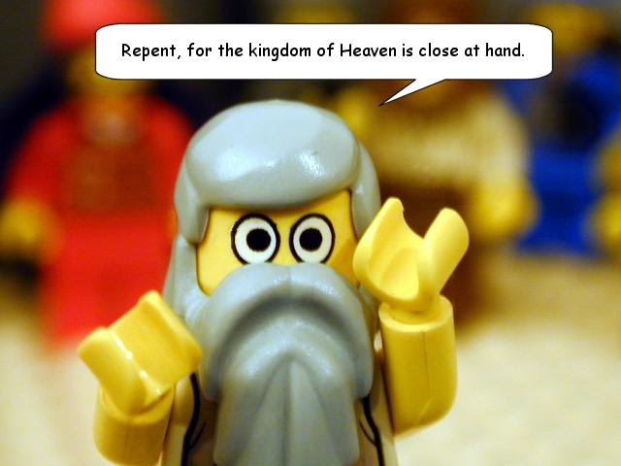
The prophets spoke out to help people recognize God’s action and God’s will for them as expressed in the covenant.
They predicted the consequences if people ignored their warnings and continued to cooperate with the forces of evil by worshipping of false gods.

Slide 31
Because it was the Holy Spirit that spoke through the prophets, what the prophets taught has permanent value. Their words continue to be God’s message and continue to have value today!

Slide 32
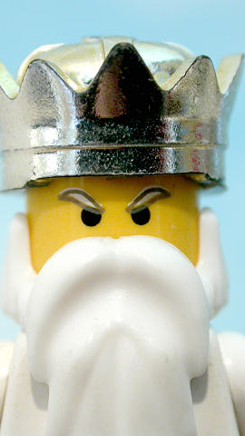
Their teachings can help us recognize God’s presence and action as well as recognize the forces of evil, lasting effects of original sin, at work in today’s society.
You will always have the living presence of the Holy Spirit within you, too. This begins at your Baptism

Slide 33
The Holy SPirit is the all- powerful bond of divine love that unites you with jesus and god the father

Slide 34
The spirit provides grace for you to respond to the love of jesus and the father and to extend that love to all you meet.

Slide 35

The Holy Spirit provides this bond for you and this grace to give others, but it does not take away your free will. You can still choose to ignore the Spirit’s promptings and gifts.

Slide 36
You are sent out to tell all who will listen to the good news of God’s love and the salvation god offers us through jesus.

Slide 37
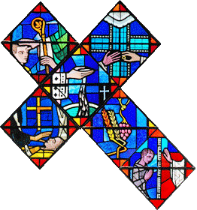
In your opinion, what characteristics of Christian maturity should a young person possess in order to be considered a good candidate for Water Baptism?

Slide 38
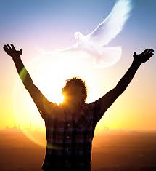
Grace from the Holy Spirit can also come at special times of need or challenge. The Spirit moves you to come to someone’s aid or to say just the right words to advise or console a friend.
Sometimes grace is just for you, to help you fight off temptation or to give you the courage to challenge some evil.

Slide 39
The Holy Spirit is always active within you…always there to guide, support, console, strengthen, and encourage.
In other words, the Holy Spirit is God’s constant love- both within you and all around you, like the water that surrounds a fish.

Slide 40

Does the Holy Spirit give more than grace? More than His presence? Read the slides below

Slide 41

Wisdom helps us recognize the importance of others and the importance of keeping God central in our lives.

Slide 42

Understanding is the ability to comprehend the meaning of God's message.

Slide 43

Knowledge is the ability to think about and explore God's revelation, and also to recognize there are mysteries of faith beyond us.

Slide 44

Right Judgment or Counsel is the ability to see the best way to follow God's plan when we have choices that relate to him.

Slide 45

Courage or Fortitude is the courage to do what one knows is right.

Slide 46

Reverence and Holiness helps us pray to God in true devotion.

Slide 47

Awe in God’s Presence or Fear of the Lord is the feeling of amazement before God, who is all-present, and whose friendship we do not want to lose.

Slide 48

Team Spirit!
God has chosen you to be on His team and gifted you with the Holy Spirit. Design a logo for the t-shirt your team will wear to signify that you have been inspired.
When you have developed your shirt, create a team motto and a prayer that your team will recite before games.

