Slide 1
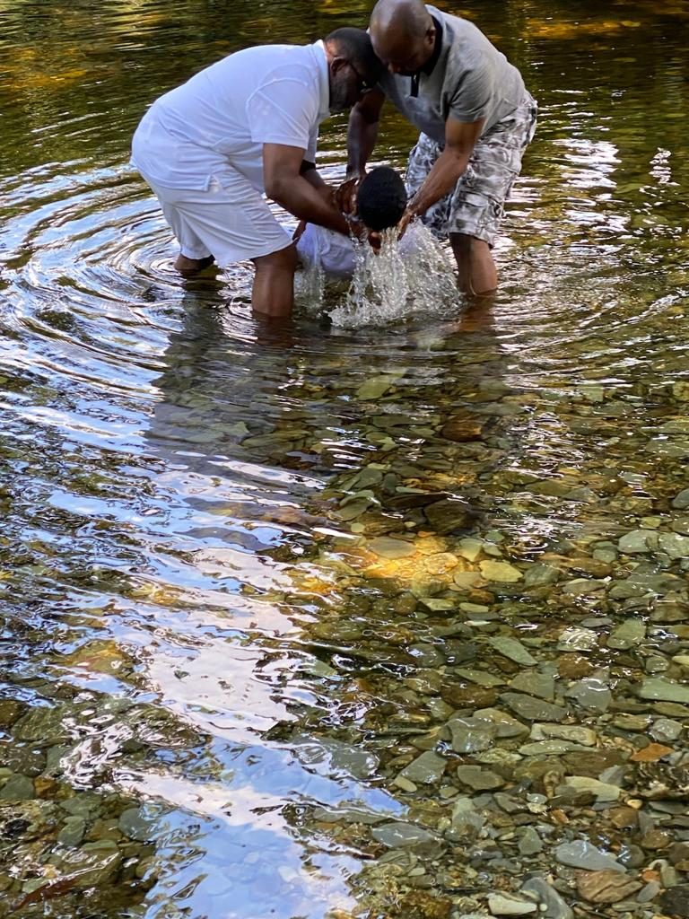
WATER BAPTISM: THE NEGLECTED CHRISTIAN ORDINANCE
JOHN 3:5
Rev. Dr. Tayo Martins

Slide 2
WATER BAPTISM: THE NEGLECTED CHRISTIAN ORDINANCE
John 3:5
5 Jesus answered, “Very truly I tell you, no one can enter the kingdom of God unless they are born of water AND the Spirit.

Slide 3
WATER BAPTISM: THE NEGLECTED CHRISTIAN ORDINANCE
WHAT IS THE MEANING OF AN ORDINANCE?
WHAT IS THE MEANING OF WATER BAPTISM?
WHO SHOULD BE BAPTIZED?
WHEN SHOULD A PERSON BE BAPTIZED?
IS WATER BAPTISM JUST A FORM OR A PATTHERN CHRISTIANS FOLLOW FOR CHURCH MEMBERSHIP?

Slide 4
WATER BAPTISM: THE NEGLECTED CHRISTIAN ORDINANCE
SHOULD ONE BE BAPTISED BY SPRINKLING, OR BY HAVING WATER POURED ON HIS OR HER HEAD OR BY BEING IMMERSED?
WHY DO THE EVANGELICAL CHURCHES HAVE SPECIAL REQUIREMENTS FOR WATER BAPTISM AND WHAT ARE THESE REQUIREMENTS?

Slide 5
WATER BAPTISM: THE NEGLECTED CHRISTIAN ORDINANCE
THE WORD ORDINANCE HAS TWO MEANINGS IN THE SCRIPTURES.
SOMETIMES IT REFERS TO THE LAWS AND COMMANDMENTS OF GOD.
OTHER TIMES IT REFERS TO THE RITES AND CEREMONIES BY WHICH WE FORMALIZE SACRED COVENANTS WITH GOD.
Exodus 12:17
¹⁷ “Celebrate the Festival of Unleavened Bread, because it was on this very day that I brought your divisions out of Egypt. Celebrate this day as a lasting ordinance for the generations to come.
.

Slide 6
WATER BAPTISM: THE NEGLECTED CHRISTIAN ORDINANCE
AN ORDINANCE IS SOMETHING THAT THE CHURCH PRACTICES BECAUSE JESUS CHRIST DID IT AND HAS TOLD THE CHURCH TO DO SO.
THE NEW TESTAMENT MAKES IT VERY CLEAR THAT THE EARLY CHURCH PRACTICED AND OBSERVED TWO ORDINANCES:
ACTS 2:41-42.
41 Those who accepted his message were baptized, and about three thousand were added to their number that day.
42 They devoted themselves to the apostles’ teaching and to fellowship, to the breaking of bread and to prayer.

Slide 7
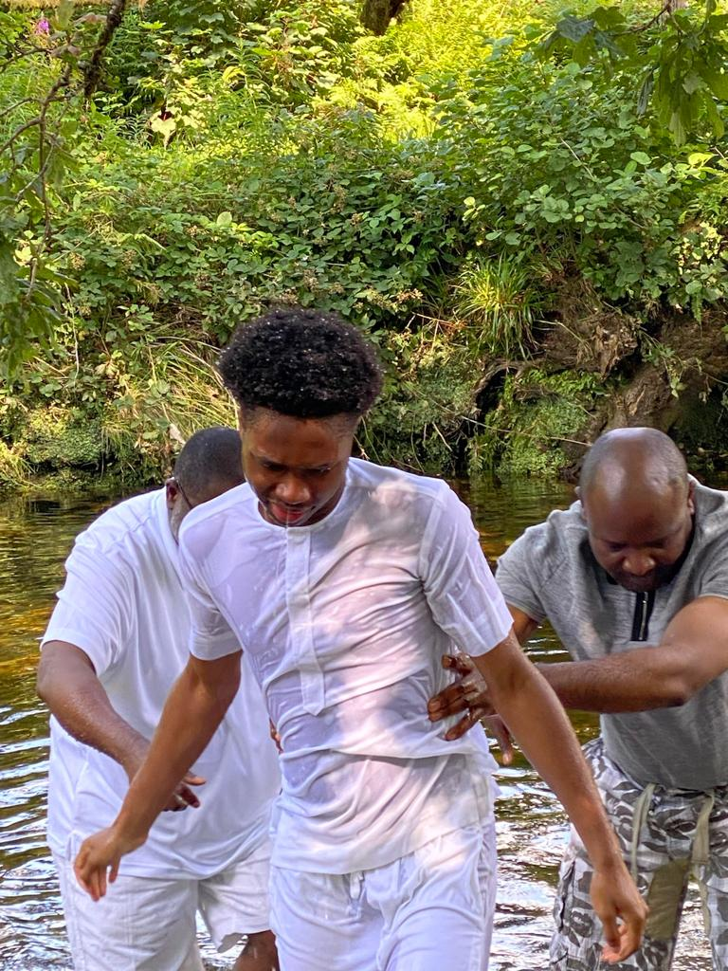
THE GREEK WORD TRANSLATED “BAPTIZE” IN ENGLISH BIBLES IS BAPTIZŌ.
ACCORDING TO GREEK SCHOLAR SPIROS ZODHIATES, THIS GREEK WORD MEANS “TO IMMERSE, SUBMERGE FOR A RELIGIOUS PURPOSE”
Notes:
© Copyright Showeet.com – Free PowerPoint Templates

Slide 8
WATER BAPTISM: THE NEGLECTED CHRISTIAN ORDINANCE
BAPTISM IS A COMMON PRACTICE IN MANY CHURCHES. HOWEVER, THERE’S MUCH DISAGREEMENT ABOUT WHAT IT MEANS AND HOW IT’S PRACTICED.
SOME CHURCHES DON’T LITERALLY BAPTIZE AT ALL, OTHERS FULLY IMMERSE PEOPLE IN WATER, AND SOME JUST USE A LITTLE WATER AND POUR OR SPRINKLE IT ON PEOPLE.

Slide 9
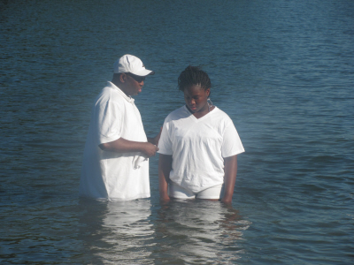
WATER BAPTISM: THE NEGLECTED CHRISTIAN ORDINANCE
SOME CHURCHES BAPTIZE INFANTS OR LITTLE CHILDREN, AND OTHERS BAPTIZE ONLY ADULTS.
CONSIDERING ALL THESE DIFFERENT IDEAS AND PRACTICES, WE MUST ASK: WHAT DOES THE BIBLE ACTUALLY SAY ABOUT BAPTISM?

Slide 10
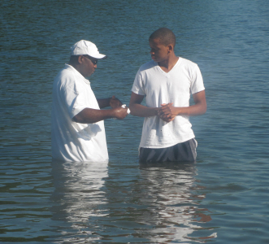
WATER BAPTISM: THE NEGLECTED CHRISTIAN ORDINANCE
THE BIBLE TEACHES THAT BAPTISM IS A CEREMONY EVERY TRULY REPENTANT PERSON MUST GO THROUGH TO HAVE HIS OR HER SINS FORGIVEN AND TO START LIVING THE CONVERTED WAY OF LIFE.
Notes:
© Copyright Showeet.com – Free PowerPoint Templates

Slide 11
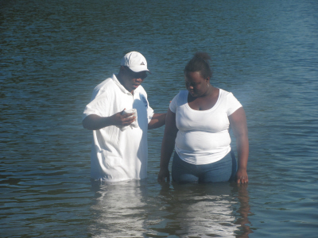
WATER BAPTISM: THE NEGLECTED CHRISTIAN ORDINANCE
THE REPENTANT PERSON IS BAPTIZED BY BEING FULLY IMMERSED, FROM HEAD TO TOE, IN WATER.
IN OTHER WORDS, BAPTISM IS A CEREMONY IN WHICH A PERSON IS SYMBOLICALLY CLEANSED OF SIN BY BEING TOTALLY IMMERSED IN WATER.
Notes:
© Copyright Showeet.com – Free PowerPoint Templates

Slide 12
WATER BAPTISM: THE NEGLECTED CHRISTIAN ORDINANCE
BAPTISM WAS DESIGNED SPECIFICALLY TO HELP US IDENTIFY WITH THE LORD JESUS
BAPTISM ADVERTISES OUR FAITH.
THIS IS A WITNESS TO OTHERS THAT WE ARE DEAD TO OUR OLD LIFE (I.E. YOUR OLD WAYS OF LIVING AND YOUR OLD SINFUL LIFESTYLE) AND NOW WE ARE TO WALK IN THE NEW LIFE PROVIDED FOR US BY JESUS

Slide 13
WATER BAPTISM: THE NEGLECTED CHRISTIAN ORDINANCE
WHAT MODE OF BAPTISM IS BIBLICAL?
IN ADDITION TO THE VERY MEANING OF THE WORD BAPTISM BEING TO IMMERSE, THE BIBLE PROVIDES ADDITIONAL EVIDENCE THAT THE BIBLICAL MODE OF BAPTISM IS TOTAL IMMERSION.

Slide 14
WATER BAPTISM: THE NEGLECTED CHRISTIAN ORDINANCE
Matthew 28:19
¹⁹ Therefore go and make disciples of all nations, baptizing them in the name of the Father and of the Son and of the Holy Spirit,
John 3:23
²³ Now John also was baptizing at Aenon near Salim, because there was plenty of water, and people were coming and being baptized.

Slide 15
WATER BAPTISM: THE NEGLECTED CHRISTIAN ORDINANCE
Acts 8:38-39
³⁸ And he gave orders to stop the chariot. Then both Philip and the eunuch went down into the water and Philip baptized him. ³⁹ When they came up out of the water, the Spirit of the Lord suddenly took Philip away, and the eunuch did not see him again, but went on his way rejoicing.
Matthew 3:16
¹⁶ As soon as Jesus was baptized, he went up out of the water. At that moment heaven was opened, and he saw the Spirit of God descending like a dove and alighting on him.

Slide 16
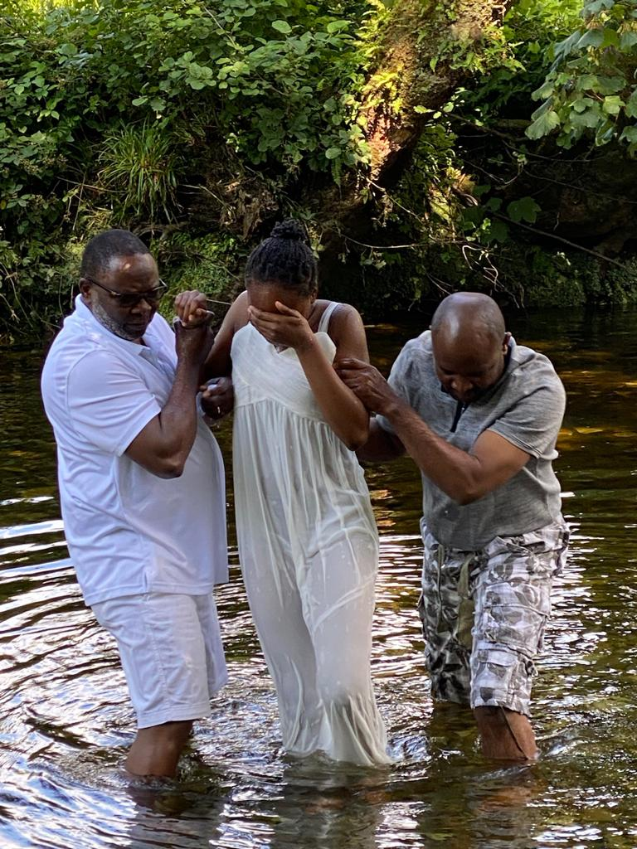
WATER BAPTISM: THE NEGLECTED CHRISTIAN ORDINANCE
TO BE BAPTIZED IN THE BIBLICAL MANNER, A PERSON MUST BE FULLY IMMERSED IN WATER, FROM HEAD TO TOE.
THREE OF THOSE SCRIPTURES SHOW US THREE IMPORTANT FACTS ABOUT BIBLICAL BAPTISM: BAPTISM REQUIRES WATER, AND A BAPTIZED PERSON GOES DOWN INTO THE WATER AND THEN COMES UP OUT OF THE WATER.

Slide 17
WATER BAPTISM: THE NEGLECTED CHRISTIAN ORDINANCE
BAPTISM IS A LOT LIKE A WEDDING RING - BOTH OF THEM SYMBOLIZE TRANSACTIONS.
A WEDDING RING SYMBOLIZES MARRIAGE, JUST AS BAPTISM SYMBOLIZES SALVATION.
NOTE THAT ‘BURIAL’ IS NEVER DONE BY ‘SPRINKLING’ A BIT OF EARTH ON THE DEAD PERSON.
- PHILIP AND THE ETHIOPIAN ‘WENT DOWN INTO THE WATER’

Slide 18
WATER BAPTISM: THE NEGLECTED CHRISTIAN ORDINANCE
WHAT ARE THE SYMBOLS OF BAPTISM?
Acts 22:16
¹⁶ And now what are you waiting for? Get up, be baptized and wash your sins away, calling on his name.’
Water - THE USE OF WATER SYMBOLIZES THE WASHING AWAY OF OUR SINS AND THE PURIFICATION OF OUR LIFE. THE OLD SINS ARE SYMBOLICALLY WASHED AWAY AND CLEANSED FROM OUR RECORD

Slide 19
WATER BAPTISM: THE NEGLECTED CHRISTIAN ORDINANCE
Romans 6:4
⁴ We were therefore buried with him through baptism into death in order that, just as Christ was raised from the dead through the glory of the Father, we too may live a new life.
GOING DOWN INTO THE WATER AND BEING FULLY IMMERSED - THIS SYMBOLIZES THE DEATH AND BURIAL OF OUR “OLD MAN” (OUR OLD SINFUL NATURE AND CHARACTER) IN THE WATERY GRAVE OF BAPTISM. WE ARE “BURIED WITH HIM THROUGH BAPTISM INTO DEATH.”

Slide 20
WATER BAPTISM: THE NEGLECTED CHRISTIAN ORDINANCE
Colossians 2:12-13
Having been buried with him in baptism, in which you were also raised with him through your faith in the working of God, who raised him from the dead. When you were dead in your sins and in the uncircumcision of your flesh, God made you^{[a]} alive with Christ. He forgave us all our sins,
COMING UP OUT OF THE WATER - THIS SYMBOLIZES OUR BEING RAISED TO A NEW LIFE. WE ARE “MADE ALIVE TOGETHER WITH HIM” AND ARE “FORGIVEN” OUR SINS.

Slide 21
WATER BAPTISM: THE NEGLECTED CHRISTIAN ORDINANCE
ALMOST EVERY CHURCH TEACHES THAT CHRISTIANS SHOULD BE BAPTISED IN WATER, BUT EVERY CHURCH DOES NOT TEACH THE SAME THINGS ABOUT “WATER BAPTISM.”
WATER BAPTISM IS NOT JUST A CHURCH MEMBERSHIP FORM
IT IS THE OUTWARD SIGN OF AN INWARD WORK OF GRACE

Slide 22
WATER BAPTISM: THE NEGLECTED CHRISTIAN ORDINANCE
Acts 2:38
³⁸ Peter replied, “Repent and be baptized, every one of you, in the name of Jesus Christ for the forgiveness of your sins. And you will receive the gift of the Holy Spirit.
Mark 16:15-16
¹⁵ He said to them, “Go into all the world and preach the gospel to all creation. ¹⁶ Whoever believes and is baptized will be saved, but whoever does not believe will be condemned.

Slide 23
WATER BAPTISM: THE NEGLECTED CHRISTIAN ORDINANCE
(b) THE OUTWARD SIGN IS TO BE BAPTISED IN WATER PUBLICLY, WHICH SHOWS THAT THIS WORK OF GRACE IS COMPLETE.
THE INWARD WORK IS TO BELIEVE THAT CHRIST DIED FOR OUR SINS AND ROSE FROM DEATH TO MAKE US RIGHT WITH GOD AND THUS WE TOO, HAVE “DIED TO SIN” AND ARE RAISED TO “WALK IN NEWNESS OF LIFE.”

Slide 24
WATER BAPTISM: THE NEGLECTED CHRISTIAN ORDINANCE
Galatians 3:27
²⁷ for all of you who were baptized into Christ have clothed yourselves with Christ.
1 Peter 3:21
²¹ and this water symbolizes baptism that now saves you also—not the removal of dirt from the body but the pledge of a clear conscience toward God.^{[a]} It saves you by the resurrection of Jesus Christ,

Slide 25
WATER BAPTISM: THE NEGLECTED CHRISTIAN ORDINANCE
ALL WHO HAVE REPENTED AND BELIEVED.
NOTE – EVANGELICALS DO NOT BAPTIZE INFANTS.
Mark 16:15-16
He said to them, “Go into all the world and preach the gospel to all creation. ¹⁶ Whoever believes and is baptized will be saved, but whoever does not believe will be condemned.

Slide 26
WATER BAPTISM: THE NEGLECTED CHRISTIAN ORDINANCE
AN INFANT HAS NOT OF HIS/HER WILL SINNED AND CANNOT REPENT OR MATURE ENOUGH TO UNDERSTAND AND BELIEVE THE GOSPEL.
TO BE A CANDIDATE FOR WATER BAPTISM ONE MUST:
BE OVER TWELVE YEARS OF AGE TO UNDERSTAND WHAT IT MEANS (Study on Human Vs. Animal growth).
HE/SHE, THEREFORE, IS NEITHER ‘IN NEED OF’ NOR ‘ELIGIBLE’ FOR WATER BAPTISM.

Slide 27
WATER BAPTISM: THE NEGLECTED CHRISTIAN ORDINANCE
NOTE: THE REASONS FOR THESE REGULATIONS ARE EASILY UNDERSTOOD.
WE BELIEVE THAT ONE MUST REACH THE ‘AGE OF ACCOUNTABILITY’, AN AGE WHEN HE/SHE KNOWS RIGHT FROM WRONG, IN ORDER TO REPENT AND BE CONVERTED.
(b) BE ‘BORN AGAIN’ AND GIVE A CLEAR TESTIMONY OF SINCERE FAITH IN THE LORD JESUS.
c) BE LIVING A CONSISTENT CHRISTIAN LIFE AND BE SEPARATED FROM OUR TRADITIONS, CULTURES AND CUSTOMS

Slide 28
WATER BAPTISM: THE NEGLECTED CHRISTIAN ORDINANCE
WE BELIEVE THAT ONE SHOULD BE FREE FROM OLD PRACTICES AND FROM BAD HABITS SO THAT THE PUBLIC TESTIMONY OF WATER BAPTISM WILL BE WITNESSED BY A CLEAN, CONSISTENT CHRISTIAN LIFE.
2 Corinthians 5:17 Therefore, if anyone is in Christ, the new creation has come: The old has gone, the new is here!
A CERTAIN WITCH DOCTORS, WAS BAPTISED IN WATER, BUT HIS HEART WAS NOT RIGHT WITH GOD.
THE CONSEQUENCE OF SUCH ATTITUDE MAY BE VERY SEVERE.
LET US READ (ACTS 8:14-24)

Slide 29
WATER BAPTISM: THE NEGLECTED CHRISTIAN ORDINANCE
I PETER 2:21
²¹ To this you were called, because Christ suffered for you, leaving you an example, that you should follow in his steps.
WHY THEN IS BAPTISM SO IMPORTANT? OR WHAT MAKES BAPTISM AN EXCELLENT WAY TO WORSHIP GOD?
NUMBER ONE - THE LORD JESUS SUBMITTED TO BAPTISM. WE ARE TO FOLLOW CHRIST’S EXAMPLE

Slide 30
WATER BAPTISM: THE NEGLECTED CHRISTIAN ORDINANCE
MATTHEW 28:19
Therefore, go and make disciples of all nations, baptizing them in the name of the Father and of the Son and of the Holy Spirit,
NUMBER TWO - BAPTISM IS IMPORTANT BECAUSE THE LORD JESUS COMMANDED HIS DISCIPLES TO BAPTIZE.

Slide 31
WATER BAPTISM: THE NEGLECTED CHRISTIAN ORDINANCE
NUMBER THREE - BAPTISM IS IMPORTANT BECAUSE THE LORD JESUS NOT ONLY SUBMITTED HIMSELF TO BAPTISM, BUT HE SANCTIONED / ENDORSED / APPROVED IT AS WELL.
JOHN 3:22 - After this, Jesus and his disciples went out into the Judean countryside, where he spent some time with them, and baptized.
JOHN 4:1-2 - Now Jesus learned that the Pharisees had heard that he was gaining and baptizing more disciples than John — 2 although in fact it was not Jesus who baptized, but his disciples.

Slide 32
WATER BAPTISM: THE NEGLECTED CHRISTIAN ORDINANCE
THE MINISTER BAPTIZING HIM OR HER WILL LAY HIS HANDS ON THE PERSON AND PRAY TO GOD, ASKING HIM TO GIVE THE PERSON THE HOLY SPIRIT. THIS IS CALLED THE “LAYING ON OF HANDS”
Hebrews 6:2
instruction about cleansing rites, the laying on of hands, the resurrection of the dead, and eternal judgment.
.
WHAT HAPPENS AFTER BAPTISM?
AFTER A PERSON IS BAPTIZED, THERE IS ANOTHER IMPORTANT CEREMONY THAT USUALLY OCCURS IMMEDIATELY AFTER SOMEONE HAS EMERGED FROM THE WATER.
Notes:
© Copyright Showeet.com – Free PowerPoint Templates

Slide 33
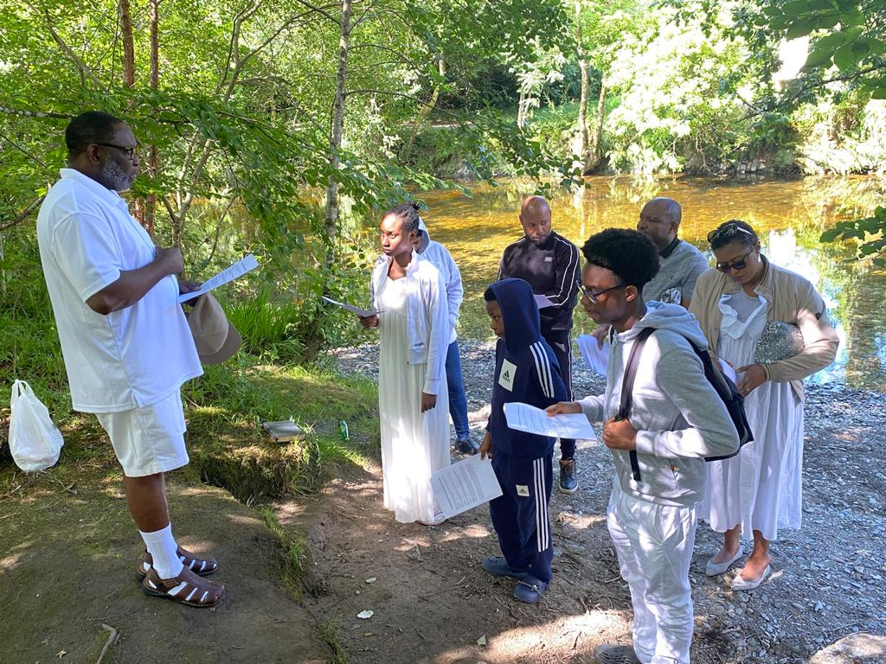
WATER BAPTISM: THE NEGLECTED CHRISTIAN ORDINANCE
IF YOU HAVE NOT BEEN BAPTIZED, OR BAPTIZED IN THE WAY CHRIST DID IT, YOU HAVE NOT FULFILL ALL THE RIGHTEOUSNESS AND YOU HAVE DENIED YOURSELF ONE OF THE BEST WAYS TO SHOW YOUR OBEDIENCE TO GOD.
MATTHEW 3:13-17
¹³ Then Jesus came from Galilee to the Jordan to be baptized by John. ¹⁴ But John tried to deter him, saying, “I need to be baptized by you, and do you come to me?” ¹⁵ Jesus replied, “Let it be so now; it is proper for us to do this to fulfill all righteousness.” Then John consented.

